Slide 1


Slide 2
Chapter 6 Network Services
Network and Security Fundamentals

Slide 3
Objectives
Describe the purpose of DHCP and Domain Name System (DNS) on network
Describe how name resolution works
Identify common network services
Describe various methods of remote administration

Slide 4
Chapter 6 – DHCP (Dynamic Host Configuration Protocol)
DHCP (Dynamic Host Configuration Protocol)
DHCP functions by leasing TCP/IP information and IP addresses to network devices for a certain amount of time. This is accomplished through a series of DHCP messages that are sent back and forth between the DHCP client and the DHCP server. The messages used in a DHCP transmission are DHCP- DISCOVER, DHCP- OFFER, DHCP- REQUEST DHCP- Acknowledge

Slide 5


Chapter 6 – DORA Process
Discover
Offer
Request
Acknowledge

Slide 6
Chapter 6 – Network Services
DNS- DNS, or the Domain Name System, translates human readable domain names (for example, www.amazon.com) to machine readable IP addresses (for example, 192.0. 2.44)
Fully qualified domain name (FQDN):A fully qualified domain name (FQDN) is one that contains both a hostname and a complete domain name.

Slide 7
Chapter 6 – Remote Networking Services
(RDS)-Remote Desktop Services, known as Terminal Services in earlier versions of Windows is one of the components of that allow a user to take control of a remote computer or virtual machine over a network connection.
(WVD)- Windows Virtual Desktop, Windows Virtual Desktop is a desktop and app virtualization service that runs on the cloud.
Set up a multi-session Windows 10 deployment that delivers a full Windows 10 with scalability
Virtualize Microsoft 365 Apps for enterprise and optimize it to run in multi-user virtual scenarios
Provide Windows 7 virtual desktops with free Extended Security Updates
Bring your existing Remote Desktop Services (RDS) and Windows Server desktops and apps to any computer
Virtualize both desktops and apps
Manage Windows 10, Windows Server, and Windows 7 desktops and apps with a unified management experience

Slide 8
Chapter 6 – Virtual desktop infrastructure (VDI)
Virtual desktop infrastructure (VDI) is defined as the hosting of desktop environments on a central server. It is a form of desktop virtualization, as the specific desktop images run within virtual machines (VMs) and are delivered to end clients over a network.
VDI is another virtual desktop solution that allows the user to access a desktop environment remotely. The desktop could be a Virtual Machine (VM) or a personal computer (PC). VDI is referred to as a centralized desktop virtualization solution. The premise behind using VDI is to run desktop client operating systems, apps, and data in a server-based VM. The user can access and interact with the desktop using the Remote Desktop Protocol (RDP).

Slide 9
Chapter 6 –(VPN) Virtual Private Network
(VPN)- Virtual Private Network- A VPN is used to send data and ensure it is secured from one private network to another private network using the Internet. A VPN creates a secure tunnel and uses encryption to make sure the information remains private. A practical way to describe a VPN is an encrypted secure connection between private networks using a public network.

Slide 10
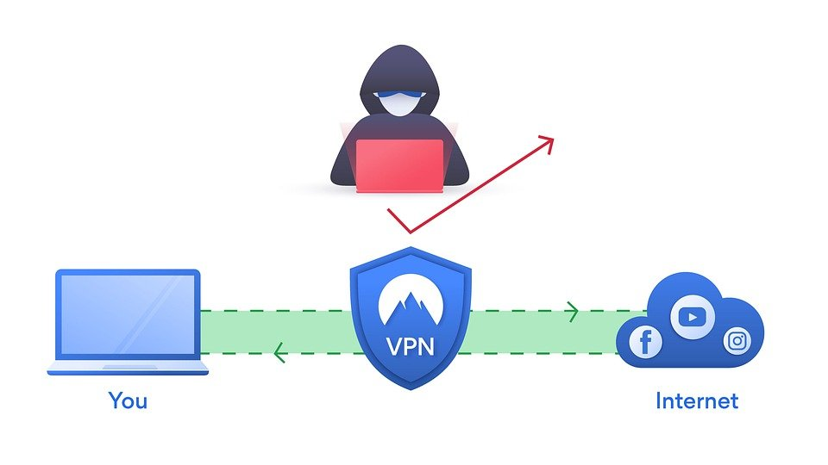
Chapter 6 – VPN Tunnel

Slide 11
Chapter 6 – VPN Remote Access and Site to Site
Remote Access VPN allows a client to connect to a private network and use its resources and services remotely. The link between the remote client and the private network is established over the Internet and creates a secure connection or tunnel to transmit data. Remote Access VPN is used often by teleworkers and users who work remotely. Remote Access VPN can also be used for home use as an extra layer of security.
A Site-to-Site VPN is used primarily on an enterprise networks within large companies. Organizations that have multiple branches or office locations in different locations would use a site-to-site VPN to connect one office location to another office location. Site-to-site VPN establishes an imaginary bridge between offices separated by a large geographical distance to create a secure and private connection from one office to another office.

Slide 12
Chapter 6 – IPsec
Internet Protocol Security, known as IPSec, is used to protect Internet messages across an IP network. IPSec fortifies IP messages by validating the session and encrypts each data packet throughout the connection. IPSec runs in two modes: Transport mode and Tunneling mode.

Slide 13
Chapter 6 –Transport Layer Security (TLS) and Secure Sockets Layer (SSL)
Transport Layer Security (TLS) and Secure Sockets Layer (SSL) create a VPN connection by using the web browser as a client. These VPN types are used to prohibit user access to specific applications as opposed to the entire network.
An easy way to identify whether your browser connection is using SSL is to see whether the URL contains “https” as opposed to “http.” A browser using SSL will display “https” to show it is secure and will establish an encrypted connection.

Slide 14
Chapter 6 – L2TP or Layer 2 Tunneling Protocol
L2TP or Layer 2 Tunneling Protocol is a tunneling protocol that is often used with an additional VPN protocol such as IPSec in order to establish a very secure VPN connection. L2TP does not provide an encryption by itself. LT2P creates a tunnel between two L2TP network devices and IPSec is used to secure communication and encrypt the data. One of the reasons that L2TP is such a popular protocol is that there are no known weaknesses or vulnerabilities.

Slide 15
Chapter 6 – Point-to-Point Tunneling Protocol (PPTP)
Point-to-Point Tunneling Protocol (PPTP) is one of the oldest protocols used on VPN networks. It is also extremely fast and is known as one of the fastest VPN protocols. However, PPTP is not very secure and has a very weak encryption standard. PPTP creates a tunnel and is used to encrypt the data between connections. PPTP is also very easy to configure and set up and is well-suited for most operating systems.

